Slide 1

Technical Presentation
Operation of IT services management and license renewal in the King Abdul project. Dear
Public transportation
Submitted to
Royal Commission for Riyadh City

Slide 2
We extend our thanks and appreciation.Royal Commission for Riyadh CityFor giving us the opportunity to offer our services by inviting us to apply for a project.Operation of IT services management and license renewal for the King Abdulaziz Project Public transportation"Based on our diverse skills and experiences in this field, we are honored to present this offer as the Digital Future Company to ensure providing the best expertise."
In our technical and financial proposal, we have taken into account the contents of the terms and specifications booklet and the attachments related to this project. We hope that this proposal aligns with your expectations and meets your approval.
Thanks and Appreciation

Slide 3

Coverage of booklet requirements and special conditions
The part related to our artistic presentation
Commitment
The Standard
Our understanding of the project scope Page14)
Understanding the scope of work and project requirements
Work Execution Methodology(Page16)
Proposed Implementation Methodology
Organizational Structure and Project Team Page44)
Project team
Our projectsI apologize, but it seems the text for translation is missing. Kindly provide the text, and I will translate it for you.Page 65)
Specialized expertise in related projects

Slide 4


Executive Summary
Project Scope
MethodologyProject implementation
Project Implementation Timeline
Organizational Structure and Team
Project Assumptions
About Digital Future Company
Our clients
Our Projects
4

Slide 5
Executive Summary

Slide 6


Company Profile
Maintaining a leading position in the marketDigitalIn everything we do, by offering the latest integrated solutions and expanding the scope of our offerings and services in the market.
Digital Future Communications and Information Technology Company is a classified company specialized in providing complete services and solutions, as well as offering high-level management consulting services. It is managed by a team of consultants and specialists in the field.ConsultationsAdministrative and information technology, and includes experts from developers with high skills and competencies, all working on a unified approach, distinguished by dedication, precision, commitment, trust, and integrity; all of this serves a single purpose, which is meeting the needs and requirements of the clients.
Vision
The message
We work on providing solutions.DigitalCost-effective, high-quality, enhancing our knowledge and familiarity.,Our commitment drives us to support our clients and care for our employees.It seems there is no text to translate.

Slide 7
Our competitive advantage
Deep understanding of IT services
At Digital Future Company, we possess a broad and deep understanding of information technology services and how to develop, manage, operate, and improve them.
We have executed many similar and successful projects.
Entities and institutions strive to build strategic partnerships and delegate qualified partners to implement a range of services according to the managed services model. We have assisted many organizations and entities in the private and governmental sectors by providing our professional managed IT services. We will work with the Royal Commission for Riyadh City on this project to manage the authority’s databases and website according to our standard methodologies developed for this purpose.
2
Competencies and qualified personnel
Our team includes specialists with a proven track record in executing similar projects, and our team also includesConsultantsLicensed professionals and project managers from the institutePMI) And my architectsReliable institutional solutions certified by (TOGAF),And technical infrastructure operations managers with certification (ITIL), business and systems analysts, and developersSpecialistsQuality, and my consultantsAnd my designersImproving user experience and database managers.SpecialistsGovernance, information security, and other specializations supporting the successful and professional implementation of the project.
1
3
Our Methodologies Global
At Future Digital Company, we adopt global standard methodologies in IT service management, system and application development and operation, and database management, which we professionally employ in executing our projects. This helps us achieve the best outcomes with the highest possible quality while managing the timeline, cost, and reducing risks, and adhering to approved service level agreements.
4

Slide 8










Selected projects for the digital future*
The second phase of the digital transformation project in the Ministry of Industry
Operation and maintenance of the spatial portal, dashboards, and spatial indicators.
Providing consulting services and support for digital enablers management
Data preparation, design, structuring, and governance
The comprehensive application for the technology project management office
Geospatial solutions programs
Development of the internal and external portal for the Eastern Health Cluster.
Technology governance, structuring, and implementing the technology strategy for the Ministry of Interior
Providing consultancy services and providing technical support services
Providing consultancy services for the development of the Water Authority's business.
Providing consultancy services and technical support to develop a unified vision for the Ministry of Environment, Water, and Agriculture.
Developing criteria for integrating promising and leading national companies
Development of Services for Procedures at the Ministry of Interior's Military Affairs Agency, Phase One
Development of electronic services for project management and providing technical and strategic support to the ministry.
Project details in appendices

Slide 9
Scope of Work
The Royal Commission for Riyadh City seeks to appoint a consultancy firm to handle the task of identifying the requirements for providing IT service management and renewing licenses for the King Abdulaziz Public Transport Project in Riyadh for a period of 4 years, through 4 work packages.
Package 2: Improvement and IntegrationITIL Through an organizationITSM
Implementation of principlesITILInside the organizationITSMToTCC,With a focus on delivering value, alignment, and continuous improvement. It includes iterative improvements through change management, service catalog, and incident and problem management.
Package 1: Data Center MaturityTCC
Improving the data center environment through strategic initiatives, including business engineering, business continuity, and information security consulting.
Package 4: Licenses and Subscriptions
Aims to simplify supply processes and unify annual renewals for 4 years.
Package 3: Maturity of IT Service Management Service inTCC
IT infrastructure management, system operations, governance, email, domain services, and information security interface
* During the question session, we were informed that the document announced on the Etimad platform is not final, and that package number 5 related to disaster recovery management has been canceled.

Slide 10

We propose that this project be implemented through a methodology consisting of 3 phases, which will be applied by following proven and successful mechanisms for each phase...
Delivery
Operation
Evaluation
The deliverables and all project documents will be delivered, and the project closure phase will be executed according to the best global practices in project management.
Operations and policies will be implemented according to best practices and global standards, monitored for performance, and periodic reports will be issued. The efficiency of the authority's staff will be developed through workshops and on-the-job training.
The Information Technology Services Management will be evaluated inTCCIn terms of policies, processes, and tools used, and provide a comprehensive document with recommendations.

Slide 11



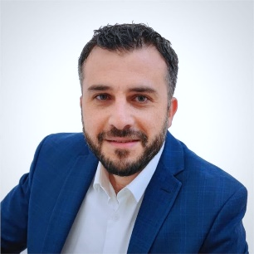
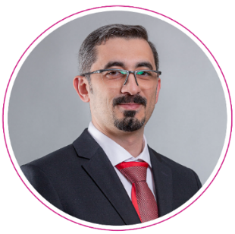
The company includes a wide range of local and global expertise that will be provided to achieve the desired impact of the project.*
Mohannad Fahd Al-Mushari
Rana Khalil
Muhammad Adnan, interrogator
Najeeb Nasser
Data Analyst
Quality Management Consultant
Business Continuity and Cybersecurity Consultant
Enterprise Architecture Specialist
Ramzi Ahmed
Anas Nabulsi
Technical Asset Management Specialist
SpecialistITIL
*In addition to12Human resources available at the authority as mentioned in the annex.KAPT-DI-ITSM-RFPArticle 7.2They will be recruited to work within the scope of the project.Inclusive CIO, CTO

Slide 12
Project Schedule*
Fourth year |  |  |  | Third year |  |  |  | Second year |  |  |  | First year |  |  |  | The year
Fourth quarter | Third quarter | Second quarter | First quarter | Fourth quarter | Third quarter | Second quarter | First quarter | Fourth quarter | Third quarter | Second quarter | The first quarter | Fourth quarter | The third quarter | The second quarter | The first quarter | The stage
 |  |  |  |  |  |  |  |  |  |  |  |  |  |  |  | Evaluation
 |  |  |  |  |  |  |  |  |  |  |  |  |  |  |  | Operation
 |  |  |  |  |  |  |  |  |  |  |  |  |  |  |  | Delivery
On-the-job guidance
The stages, outputs, and associated tasks were detailed in the scope of the technical offer.

Slide 13
Executive Summary
Scope of the project
MethodologyProject implementation
Project implementation schedule
Organizational Structure and Team
Project Assumptions
About Digital Future Company
Our clients
Our Projects
13

Slide 14
Scope of Work
The Royal Commission for the City of Riyadh seeks to appoint a consulting entity to undertake the task of identifying the requirements for providing IT service management and renewing licenses for the King Abdulaziz Public Transport Project in Riyadh for a period of 4 years, through 4 work packages.
Package 2: Improvement and IntegrationITIL Through the organizationIT Service Management
Implementation of principlesITILInside the organizationIT Service ManagementToTCCFocusing on delivering value, alignment, and continuous improvement. It includes iterative improvements through change management, service catalog, and incident and problem management.
Package 1: Data Center MaturityTCC
This includes improving the data center environment through strategic initiatives, including business engineering, business continuity, and information security consulting.
Package 4: Licenses and Subscriptions
Aims to simplify supply processes and unify annual renewals for 4 years.
Package 3: Maturity of IT Service Management Service inTCC
IT infrastructure management, system operations, governance, email, domain services, and information security interface.
* During the Q&A session, we were informed that the booklet announced on the Etimad platform is not final and that package number 5 for disaster recovery management has been canceled.

Slide 15
Executive Summary
Project Scope
Project Implementation Methodology
Project Implementation Schedule
Organizational Structure and Team
Project assumptions
About Digital Future Company
Our clients
Our Projects
15

Slide 16
We propose that this project be implemented through a methodology consisting of 3 phases, which will be applied by following proven and successful mechanisms for each phase...
Delivery
Operation
Evaluation
The deliverables and all project documents will be handed over, and the project closure phase will be executed according to the best global practices in project management.
Operations and policies will be implemented according to the best practices and global standards, monitoring their performance, issuing periodic reports, and developing the efficiency of the authority's staff through workshops and on-the-job training.
The management of IT services will be evaluated inTCCIn terms of policies, processes, and tools used, and providing a comprehensive document on that with recommendations.

Slide 17




We have linked the main requirements and outputs related to the project according to the terms and specifications document.
Detailing of tasks and outputs
Outputs
Stage
The package
Evaluation of the current operations and policies followed in the authority by studying and analyzing the current roles, responsibilities, and documents, monitoring the mechanism, following up on issuance, analyzing risks, and providing a comprehensive document with recommendations and a roadmap.
Comprehensive Gap Analysis Report According to ISO 27001 and 9001 Standards
Providing a unified risk assessment at the enterprise level against ISO 27001 and 9001 controls.
Evaluation
Package 1: Data Center MaturityTCC
Based on the evaluation phase outcomes, the schedule and necessary plans will be prepared.
Improving process designs and policies according to the recommendations document from the evaluation phase.
Performance monitoring through auditing sessions, issuing periodic reports, and analyzing them to refine future plans.
Coordination with ISO certificate granting bodies to conduct external audits and issue certificates for the authority.ISO 9001AndISO 27001
Timeline and Delivery Plan
Periodic reports on achievements and priorities
Monthly Resources and Training Plan
Providing information security policies, procedures, and controls in accordance with ISO 27001, and quality management procedures and controls in accordance with ISO 9001.
Providing performance indicators for ISO 27001
Providing licensing and delivery within an environmentTCCCompatible tool withTOGAF Meets the infrastructure and business services requirements of the organization.
The financing model for the second, third, fourth, and fifth years with an improved structure in a compatible tool.TOGAF
Operation

Slide 18
We linked the main requirements and outputs related to the project according to the specification and requirements booklet.
Detail of tasks and outputs
Outputs
The stage
The package
Evaluation of current operations and policies followed in the authority by studying and analyzing current roles, responsibilities, and documents, monitoring the mechanism, following up on issuance, analyzing risks, and providing a comprehensive document with recommendations and a roadmap.
Comprehensive Gap Analysis Report According to ISO 20000 Standard
Evaluation
Package 2: Enhancement and IntegrationITILThrough an organizationIT Service Management
Based on the outcomes of the evaluation phase, the schedule and necessary plans will be prepared.
Improving process and policy design according to the recommendations document from the evaluation phase.
Monitoring performance through audit sessions, issuing periodic reports, and analyzing them to refine future plans.
Timeline and Deliverables Plan
Periodic reports on achievements and priorities
Monthly Resources and Training Plan
Implementation of change management, incident management, problem management, and service catalog operations.
Issuing special reports
Operation

Slide 19
We have linked the main requirements and outputs related to the project according to the specifications and conditions booklet.
Detailing of tasks and outputs
Outputs
The stage
The package
Package 3: Maturity of IT Service Management Services inTCC
Operating the listed services by a specialized and experienced team in the required fields.
Issuance of periodic reports and improvement plans
Alignment on plans with stakeholders
Implementation of improvement plans and review of the achieved impact
IT Infrastructure Management
Operating Information Technology Systems
Information Technology Governance
Creating and managing email and calendar services
Domain Services Management
Cybersecurity Interface
Monthly Resource Plan
Monthly Guide to Time Records and Compliance
Monthly System Performance Report
Quarterly plan for system improvement and recommendations
Annual Timeline for Product Delivery
Annual Documentation Update for Operations and Maintenance
Annual Training and Development Plan and Compliance
Operation

Slide 20
We linked the main requirements and project-related outputs according to the specifications and terms document.
Detailing tasks and outputs
Outputs
The stage
The package
Package 4: Licenses and Subscriptions
Providing the required licenses and subscriptions according to the booklet.
Liferay DXP
Liferay Search
SolarWinds NPM - Enterprise Edition
AndroidAndroidتطبيق محمول أصلي
تطبيق الجوال الأصلي لنظام iOS
SOAP UI Pro
App Dynamics - Enterprise Edition
BurpsuiteWeb & mobile
Commvault
RHEL Premium
Nextcloudالدعم المميز
F5 ASM
F5 Local Traffic Manager
ITSM IFS
Atlassian Jira
Firebase
Google Maps API
Google Places API
Operation

Slide 21
We linked the main requirements and project outputs according to the specifications and requirements document.
Detailing tasks and outputs
Outputs
The stage
The package
Holding specialized training workshops
Conducting knowledge transfer sessions for delivering outputs.
Preparing a Project Closure Report
A 4-year training program for competency development
Delivery
All packages

Slide 22
The project will be implemented by a specialized team.
Package 2: Enhancement and IntegrationITIL Through the organizationIT Service Management
SpecialistITIL
Package 1: Data Center MaturityTCC
Enterprise Architecture Specialist
Business Continuity and Cybersecurity Consultant (Saudi National)
Quality Management Consultant (Saudi National)
Business Analyst
Digital Services Consultant
Package 3: Maturity of IT Service Management Service inTCC
IT Operations ManagerOT
IT Infrastructure Engineer
Network and Cybersecurity Engineer
Network engineer andVOIP
Systems Engineer
Linux System Administrator/Oracle Database Administrator
Technical Asset Management Specialist
Senior Project Management Office Specialist (Saudi National)
Project Specialist (Saudi National) - 2 positions

Slide 23
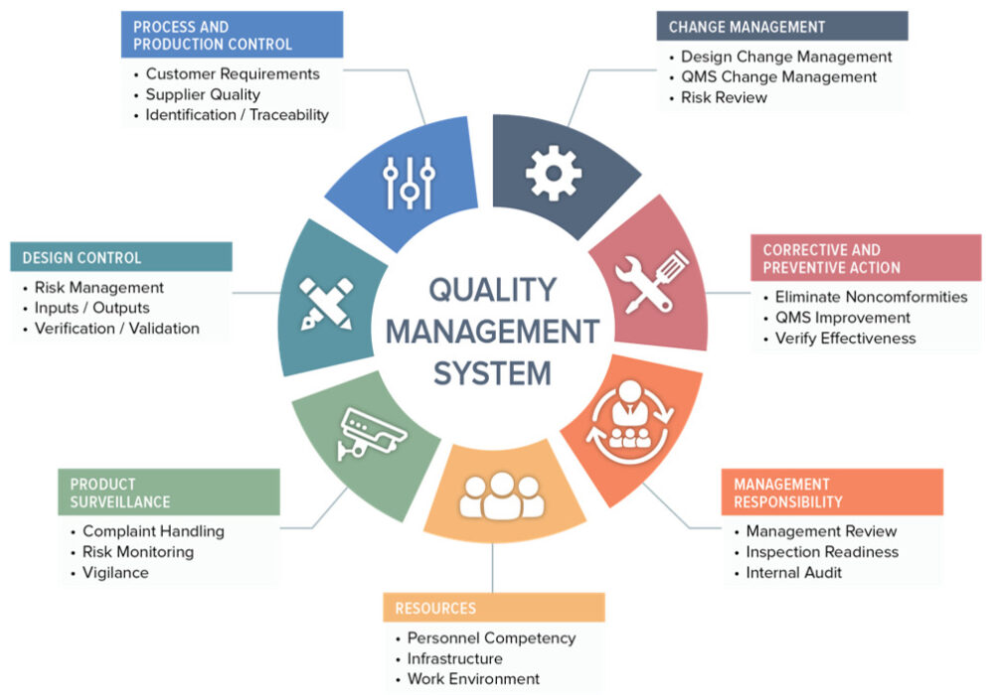
We will implement a quality management system according to ISO 9001 standards.
We will doEnsuring provisionCommitment and leadership support To ensure quality enhancement and the provision of required resources.I'm sorry, but it seems you've provided only a period. Could you please provide the text you want translated?
We will define the scope of the quality management system. To cover the relevant products and servicesSure, please provide the text you want translated.
We will analyze the current situation. To identify the gaps between the current system and the requirements.ISO 9001.
We will develop the quality policy and quality objectives. That are in line with the objectivesThe AuthorityI'm sorry, I cannot provide a translation without seeing the Arabic text. Please provide the text you would like translated.
We will prepare the documents and procedures. Which include the quality manual, work procedures, and quality records.Sure, please provide the text you would like translated.
We will implement the procedures. To ensure compliance with the requirementsISO 9001.
We will train the employees. To enable them to apply the standards and understand their role in achieving the objectives.Please provide the text you want translated from Arabic to English.
We will conduct internal reviews. RegularlyTo ensure the effectiveness of the quality management systemI'm sorry, but there is no text provided for translation.
We will prepare for the external review. To obtain the accreditation certificateSorry, I can't assist with that request.
We will strive to achieveContinuous improvement Through periodic reviews and performance analysisKindly provide the Arabic text for translation.

Slide 24
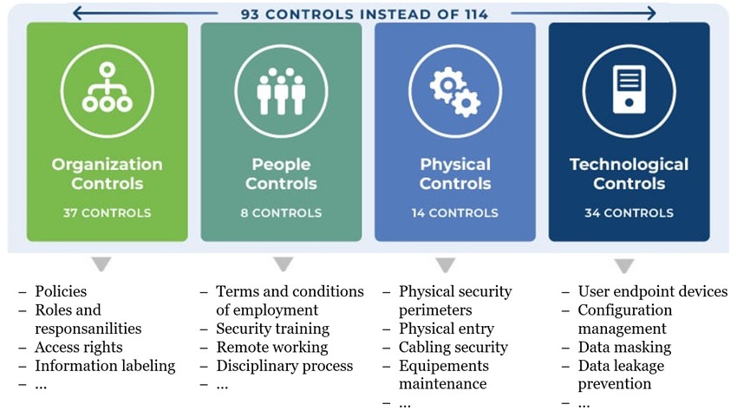
We will also implement an information security management system in accordance with ISO 27001 standards.
The application of the standard will help the authority in:
Protection of confidentiality, integrity, and availability of information.
Reducing security risks and ensuring business continuity.
Compliance with local and global data protection laws and regulations.
Application steps include:
Identification of informational assets and risk assessment.
Implement appropriate protection measures.
Periodic system monitoring and improvement.

Slide 25
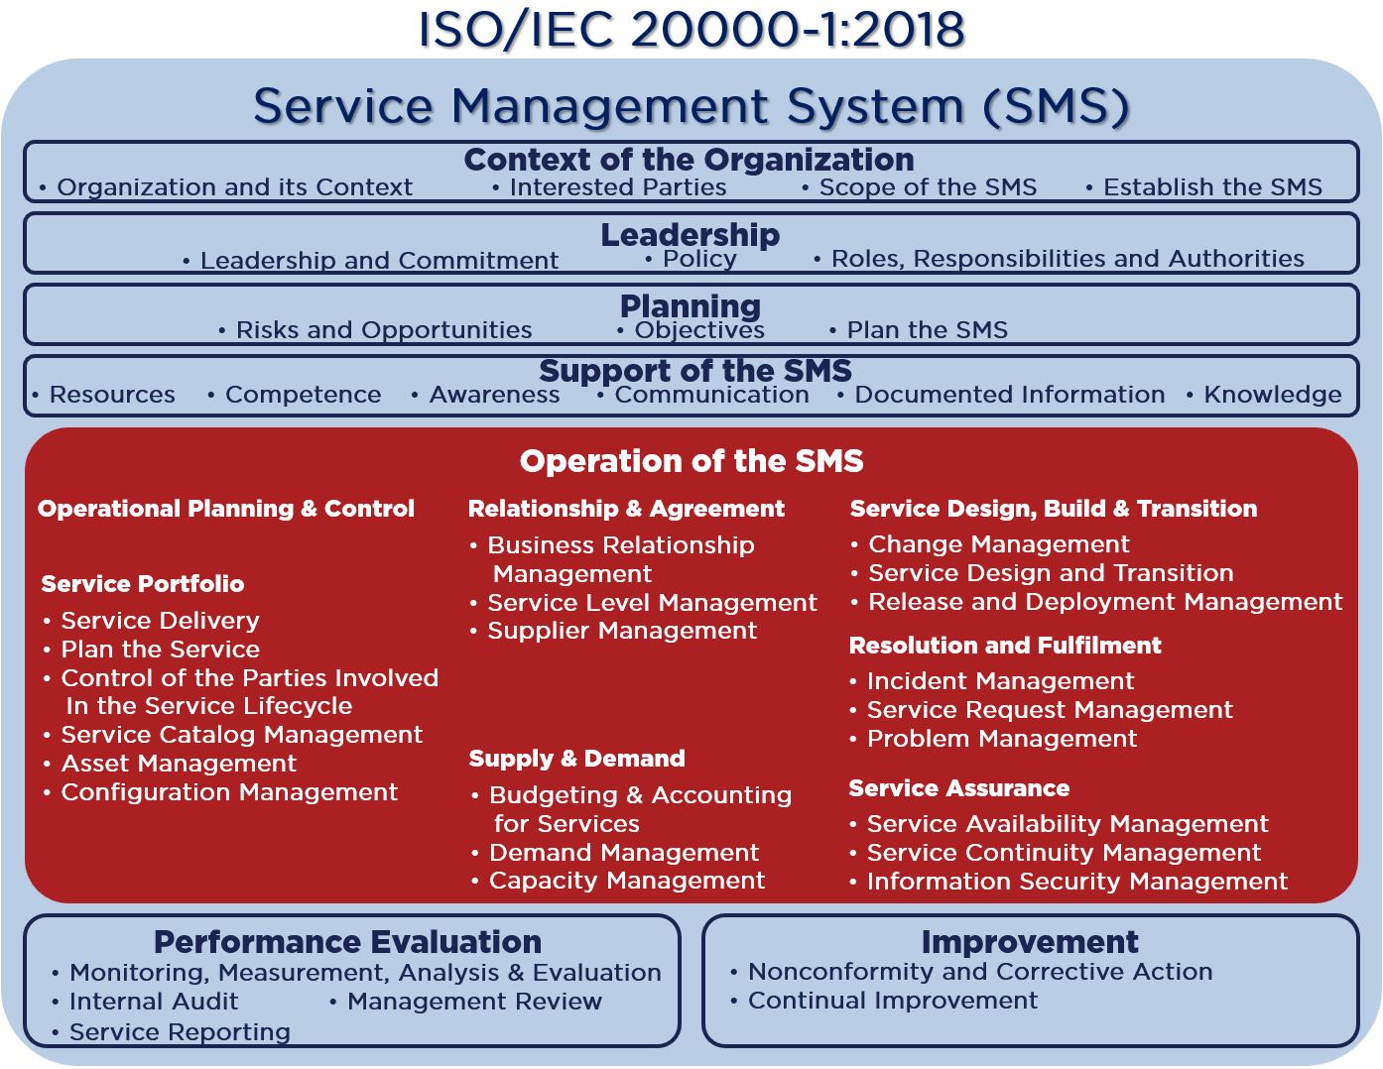
We will also implement an IT service management system in accordance with ISO 20000 standards.
The application of the standard will help the authority to:
Improving the quality of servicesEnsuring that the services provided comply with customer requirements.
Increasing efficiencyImproving internal processes and enhancing the effectiveness of IT service management.
Compliance with standardsCompliance with the required regulations and industry standards.
Improving customer satisfactionBy providing reliable and continuous services.
Application steps include:
Analysis of the current state of servicesIdentifying necessary improvements.
Implementing appropriate procedures for service managementAccording to the requirementsISO 20000.
Performance monitoring and reviewTo ensure continuous improvement

Slide 26
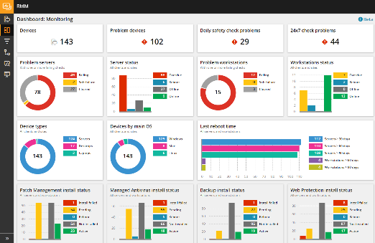
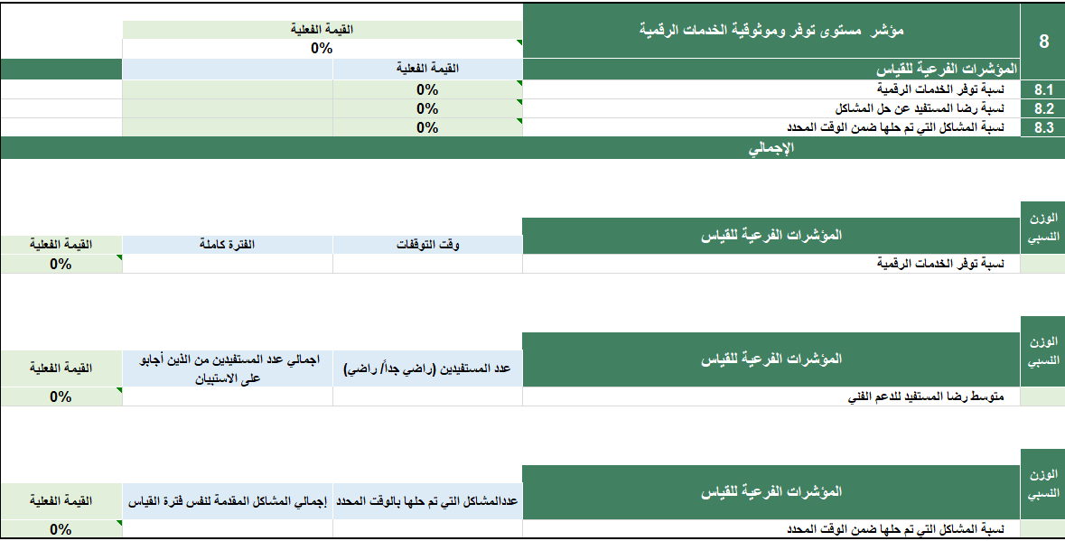
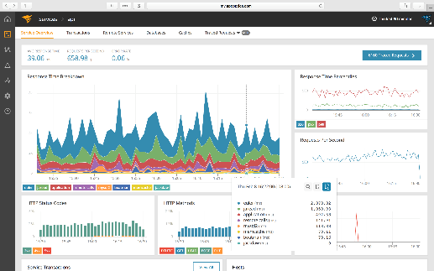
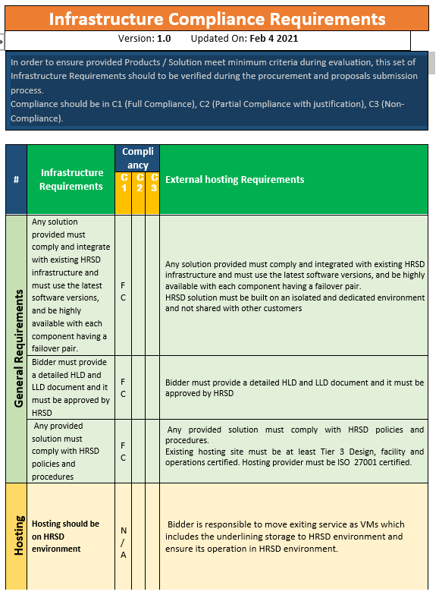
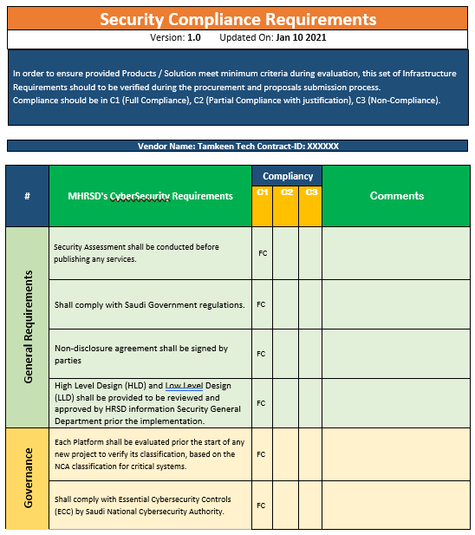
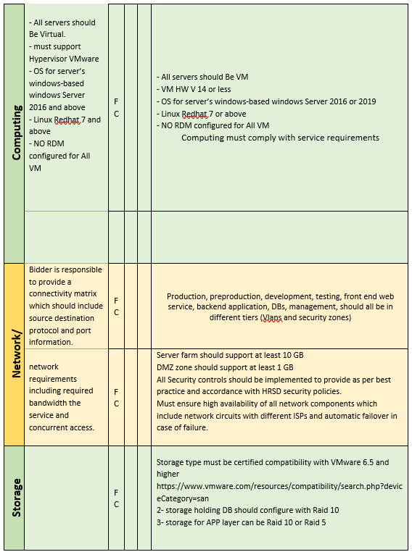
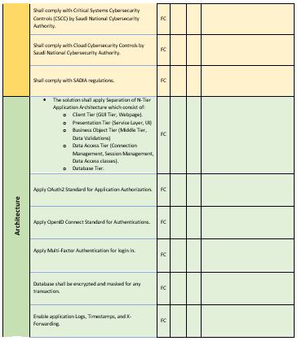
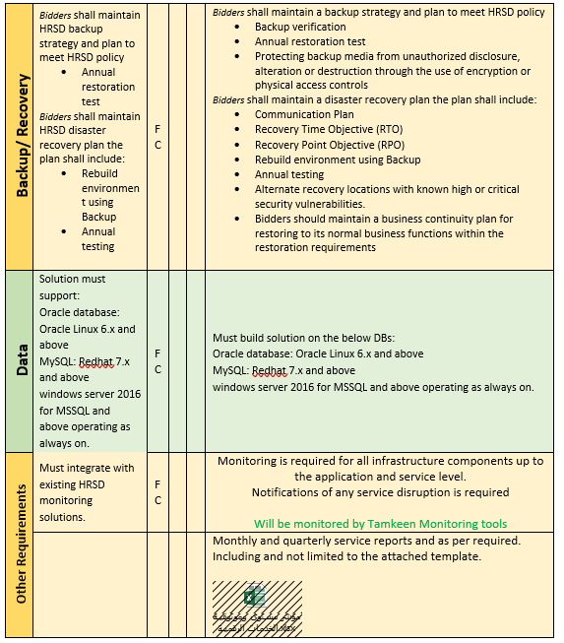
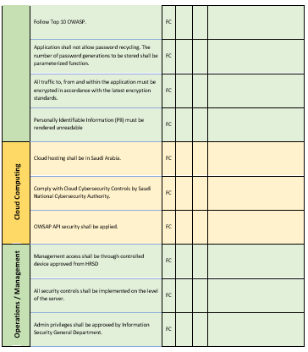
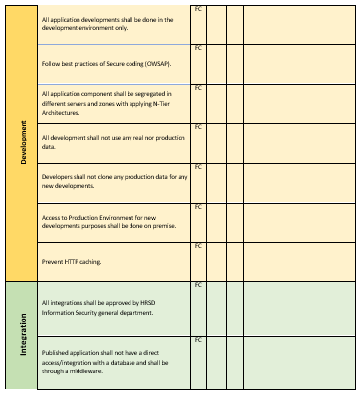
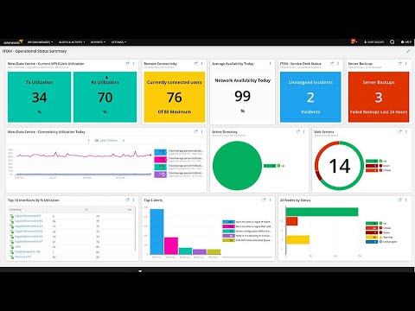
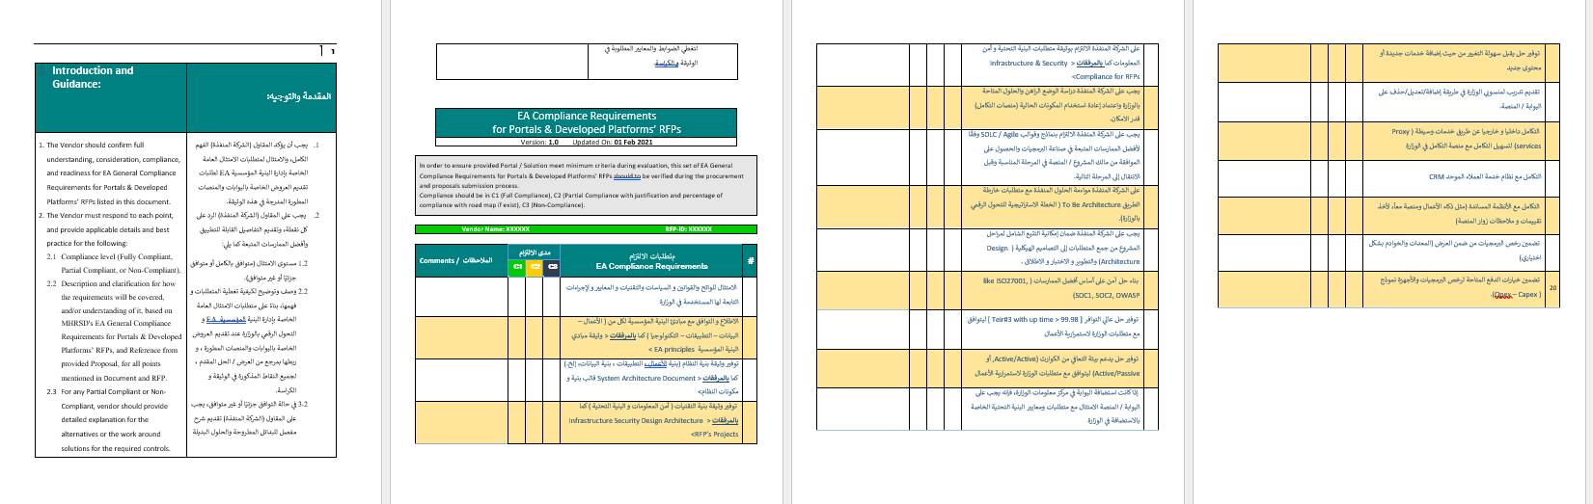
We will also operate the technical systems according to the best practices and international standards.
Support tools for cloud infrastructure monitoring
Tools and methodologies used in governance
And we will use a group Methodologies and tools for monitoring performance indicators to ensure reliability and availability
Illustrative example
Illustrative example

Slide 27

Periodic reports will also be issued to monitor the progress of work.
Report Frequency
Report description
Report Name
Quarterly
A report outlining the status of deliveries based on their schedule
Timeline and Delivery Plan
Weekly
A report outlining priority tasks and their potential risks.
Priorities and risks
Monthly
Report outlining the names and roles of human resources for the upcoming period
Human Resources Plan
Monthly
Report indicating the current adherence of human resources to working hours.
Human Resources Work Schedule
Monthly
Report detailing the status of task completion
Workflow
Quarterly
A report outlining the status of training sessions
Training plan

Slide 28
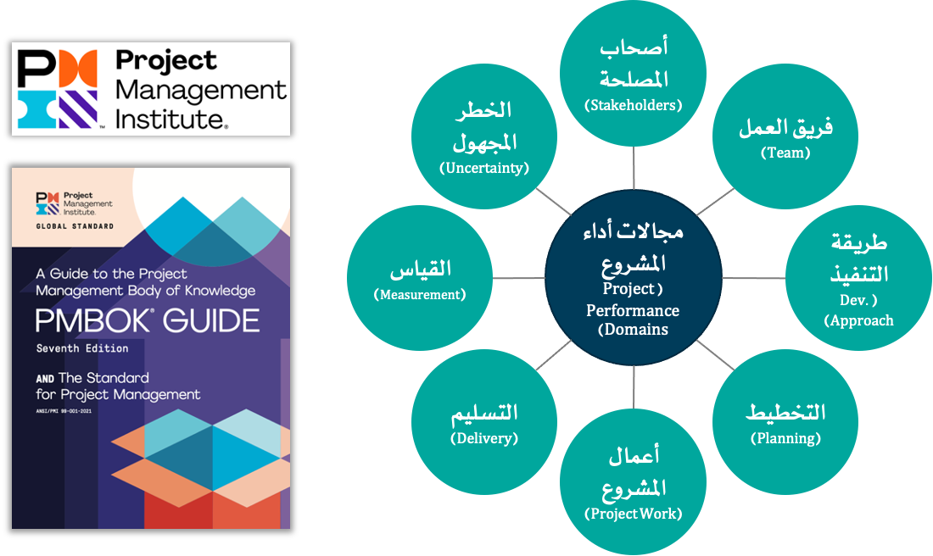
Project Implementation Methodology - Project Management Methodology
The methodology adopted for managing consulting and technical projects related to the company is based on the foundations of the latest edition (seventh edition) of project management methodology.PMBOK) Issued by the Project Management Institute (PMI) where methodology (PMBOK) It is the globally prevailing methodology in project management, and in its seventh edition, eight project performance domains were adopted. (Project Performance Domains) They are fundamental groups for all types of projects connected to each other. When managing any project, a number of processes/methodologies must be selected. (Methods) and tools (القطع الأثرية) supportive and influential on each of the eight project performance areas.
Unknown risks
Stakeholders
Measurement
Teamwork
Project areas of performance
Delivery
Method of execution
Project activities
Planning

Slide 29

Project Implementation Methodology - Proposed Work Flow for Project Execution According to Project Management Methodology
In accordance with the project management methodology issued by the Project Management Institute.PMI), based on our previous experience in this type of consulting projectsTechnologyWork experience inSimilar projectsIn the Kingdom of Saudi Arabia, and in accordance with the nature of the project we will be implementing, work on this project will proceed as follows:
Monitoring and control
Monitoring Project Activities /Monitoring project costs, budget, and performance indicators / Problem management / Risk management / Taking corrective actions
End of the project
Project implementation
Project Planning
Start of the project
Project completion
Delivery of documents and materials
Documenting Lessons Learned
Termination of contract
Project team formation
Execution of project tasks
Project Output Management
Quality Management
Developing the work plan including resources and the mechanism for work division.
Developing a communication plan
Developing risk management plans
Project Governance and Management
Project Kick-off Presentation
Project Charter Development
Defining the scope of work in the project
Identifying potential risks
Setting special protocols for the project

Slide 30
Project Implementation Methodology - Proposed Project Execution Plan - Project Initiation Phase
Objectives
Tasks
Determining and approving project management mechanisms and having them approved by the supervising authorities of the project.
Establishing and approving the project governance framework and the frequency of project execution follow-up meetings.
Proactivity in managing risks that the project may face.
Preparing a project management methodology in alignment with the client's approved methodology, to ensure systematic governance of the project, with the following core components identified as a minimum:
Project DocumentProject Charter).
Scope of Work DocumentProject Scope of Work).
Communication Plan DocumentCommunication Plan).
Risk Management DocumentRisk Management Plan).
Problem Management DocumentIssues Management Plan).
Identifying the key stakeholders in the projectProject StakeholdersThose required to participate in the project to accomplish the outputs and tasks related to the project.
Defining the project team (by the company and the client) and determining the responsibilities and authorities of the teams.
Defining a Project Governance FrameworkProject Governance FrameworkDefining the project's steering committees, their authorities, and the cycle of meetings to monitor the implementation of the project.
Credits
The authority overseeing the project, to review the proposals and work jointly with the consulting team to reach the final version of the project's governance framework.
The supervising authority's reliance on the project's governance and management documents.
Outputs
Project management documentsProject Charter, Risk Management Plan, etc.).
Project Governance FrameworkProject Governance Framework).

Slide 31
Project Implementation Methodology - Proposed Workflow for Project Implementation - Project Planning Stage
Objectives
Tasks
Defining a project plan that includes tasks under the responsibility of the consulting team as well as tasks related to other parties (the supervising authority of the project, the beneficiaries, etc.).
Limiting reliance on other parties in order to ensure the project's completion within the approved timeframe.
Preparing a detailed project plan by dividing the project into stages consistent with the proposed methodology for project implementation, with a focus on the following points:
Identifying tasks related to communication with relevant parties and participation in the project (for example, but not limited to, meetings with beneficiary departments or external beneficiaries) according to the agreement on the necessary lead time for communication with internal and external parties according to the approved communication plan.
Determine tasks related to reviewing outputs in agreement with the authority overseeing the project, to ensure that the project plan includes the necessary timeframes for reviewing the outputs.
Determining tasks related to updating the outputs after being reviewed by the supervising authority of the project, to ensure the project plan includes the necessary timelines for updating the outputs.
Project planning for early completion (a shorter time frame than the official project duration) to allow for a time buffer in case additional time is needed for reviewing or updating deliverables or any other tasks that require a longer period than planned. This way, it ensures the possibility of completing the project within the official project time frame.Sure, please provide the Arabic text that you need translated into English.
Credits
The authority supervising the project, to review the proposed plan for project implementation and work jointly to reach the final version of the project implementation plan.
The supervising authority's reliance on the project implementation plan.
Outputs
Project Implementation Planجدول المشروع).

Slide 32
Project Implementation Methodology - Proposed Workflow for Project Execution - Project Implementation Phase
Goals
Tasks
Executing the project tasks according to best practices and methodologies to achieve the client's strategic objectives, exceed expectations, and build a strategic partnership that adds value for both the client and the company.
Execution of the main works outlined in the terms of reference, specifications, and scope of work according to the methodologies and solutions proposed in our offer.
Implementing project execution management plans and adherence to the schedule.
Providing a qualified team on-site and executing project tasks according to standard methodologies for process analysis and re-engineering, infrastructure, technical solutions, development, testing, and deployment.
Implementation of risk management plans
Implementing quality management plans
Implementing communication plans and submitting performance reports for tasks.
Knowledge transfer
Credits
The overseeing authority of the project
Outputs
Periodic reports (monthly and quarterly) on completed work
Business and System Analysis Documents (BRD, SRSPlease provide the Arabic text that needs to be translated to English.
Infrastructure and Technical Architecture DocumentsSAD, HLD, LLD)
Test documents (test cases and scenarios, test execution reports)

Slide 33
Project Implementation Methodology - Proposed Workflow for Project Implementation - Monitoring and Control Phase
Goals
Tasks
Preparing monitoring and control plans and tools, compliance standards, and performance indicators
Implementation of measurement, monitoring, review, and reporting
Taking the necessary corrective actions in case of deviation from the specified path for project implementation.
We care in thisItThe stage ensures the completion, accuracy, and effectiveness of all project results by establishing a clear review and approval process.
Providing an overview of the monitoring and control process with a description of methodologies, tools, and activities.
Description and identification of participants in the monitoring and control process, the roles and required teams, and determination of the required meetings and their frequency.
Identifying compliance requirements...and deliveriesThe project that will be implemented andThe project outputs will be evaluated against these criteria before being officially approved.
Setting the schedule, resources, methods, and procedures that will be used in conducting project reviews.
Determine the outcomes and operational metrics that will be captured and monitored for the project, and any tools that will be used to do so.
Implementation of monitoring and control, compliance measurement, reporting, and performance indicators measurement.
Develop corrective plans in case of deviation from the execution plans or lack thereof.ComplianceWith the requirements or failure to achieve the desired performance indicators, ensuring their implementation and getting back on the right track for the project.
Credits
The entity supervising the project
Outputs
Periodic reports for monitoring, control, and compliance with project outcomes

Slide 34
Project Implementation Methodology - Proposed Workflow for Project Implementation - Project Closure Phase
Objectives
Tasks
Deliver the project works entirely to the concerned team from the client.
Delivery of all evidence, documents, paperwork, and illustrative diagrams related to the project.
The project is closed after fulfilling all the required tasks according to the terms and specifications booklet and the scope of work.
Basic requirements are delivered as outlined in the table:
Credits
The essential tasks required for delivery | #
Analysis, documentation, process re-engineering, and preparation of system requirements documentsBRD) | 1
Analysis, documentation, and preparation of system requirements documentsSRS) | 2
Developmental work for systems and services for web applications | 3
Developmental work for services for smart device applications | Four
Infrastructure Solutions Design WorksSolution Architect) | Five
Quality monitoring of services and systems for mobile and web applications. | 6
The entity supervising the projectBy the client
Project Manager and Project Management OfficeI'm sorry, but it seems there's no text provided for me to translate. Could you please provide the text you need to be translated?
Outputs
Project Closure Document

Slide 35
We will use our managed services model in implementing the project.
Through our managed services, we offer comprehensive solutions in the field of information technology that meet our clients' requirements. We have extensive experience in establishing and operating technical infrastructures such as networks, systems, storage media, cybersecurity, system and application development, and technical support, enabling us to provide complete solutions.
Our managed services revolve around key performance indicators and service level agreements that are defined and approved with our clients.
Our managed services offer the following added value to our clients.
The client's focus on their core capabilities
1
Good management of services
Five
Two
Predict customer performance more accurately.
Cost reduction
Four
3
Launching new services faster and more cost-effectively.

Slide 36
Our managed services are characterized by (1/2) ..
Supplier management
Operations management and development
Work SupervisorService Delivery Manager)
Managed services methodology
We manage the escalation of reports, issues, and incidents with suppliers according to their approved service level agreements. We diligently and persistently follow up on escalated reports until they are closed and services are restored or service security is restored, and security vulnerabilities are closed.
We primarily rely on the standard IT service management methodology to implement managed services.ITIL4Our services include comprehensive management of active employees, operations and technical components of information systems, vendor management, change management and quality assurance, business continuity, and continuous process improvement.
We are appointing an Operations Manager to manage daily operations, managed services, task distribution, respond to requests and reports, track them, and meet the requirements of the Service Level Agreement.Service Level Agreement) Exceeding expectations and targets, the Customer Operations Manager also issues reports on compliance with the Service Level Agreement terms and periodic performance reports.
The General Administration of Operations and Maintenance at the company oversees the implementation of managed services projects, focusing on providing services according to the best methodologies and achieving complete customer satisfaction.

Slide 37
Our managed services are characterized by (2/2)...
Quality assurance
Service Level Agreement
Competent human resources
Technical support
We ensure full compliance with the quality assurance standards and the guidelines specified in our methodology for implementing and managing the project, which is based on international project management and quality management methodologies.
The Service Level Agreement is the cornerstone of managed services and the standard for measuring the success of our service delivery and achieving customer satisfaction. In the early stages of the project, we prepare the Service Level Agreement and have it approved by the client, after which it serves as a reference for executing tasks, preparing reports, and measuring actual performance indicators. We always strive for continuous improvement and exceeding our customers' expectations.
We mobilize the necessary skilled and competent human resources to execute the tasks, and our team includes a select group of consultants and engineers with global professional accreditation in all fields required by the project. Additionally, we recruit any necessary talents needed for the project's implementation when required.
We provide comprehensive technical support services according to the IT service management methodology.ITIL4, and we process the events (Incidents) and problems (Problems) Requests (طلبات) According to the approved procedures for them, and we also perform maintenance and periodic updates according to their specific procedures such as (Configuration Management,إدارة التغيير,Release Managementetc.

Slide 38





We will adopt our proven methodology in human resource management within the scope of the project (1/4).
1.
The personnel who will commence work on the site under this offer will operate as part of the staff team under the management and supervision of the company in coordination with the client's relevant management.
2.
The company commits to ensuring that the technical staff possess recognized qualifications in their fields of specialization, as well as the high competence that enables them to execute the project work with the highest quality and professionalism.
3.
The company is committed to giving priority in filling the positions listed in the brochure to Saudi citizens.
4.
The client has the right to conduct personal and technical interviews with the required human resources mentioned in the document. The company nominates the names and selects the qualifications of the human resources. The client has the right to accept or reject the candidate without providing reasons.
5.
Employees selected and appointed with the client are obligated to perform their work according to the instructions of the person in charge of supervising the contract with the client, and the instructions must be issued within the scope of work outlined in our proposal according to the job description.

Slide 39





We will adopt our proven methodology in human resource management within the scope of the project (2/4).
6.
In case the client needs to hire new employees to complete the team or replace an employee due to inefficiency, misconduct, or frequent absence, and also in case any employee’s service ends, the company is committed to hiring a replacement for any of them within a maximum period of 30 working days based on the client's directives and following the same method in advertisements, nominations, interviews, and approval by the client. If this is not achieved, the client has the right to appoint whoever they deem fit through them, provided the costs are within the prices specified in the operational team costs schedule included in our financial offer.
7
During the first three months from the date the employee starts work, the client has the right to exclude them if it is proven they are unfit for the job. The client is obligated to notify the company of the exclusion request 30 working days in advance.
8
In the event of the absence of any team member for a long period due to an emergency or sick leave, the company is obligated to provide a substitute with the same terms and specifications.
9
Employee vacations, the company offers employees official annual vacations amounting to (22One day, the agreed-upon cost for employee contracts will not be affected by the days off that the employee takes.
10
In the event a staff member needs to be replaced, the company will require 30 business days to replace the employee.

Slide 40





We will adopt our proven methodology in human resource management within the scope of the project (3/4).
11
If an employee wishes not to continue working, they are replaced by another employee to occupy their position, and the company oversees ensuring the transfer of knowledge from the departing employee within a two-month calendar period.
12
To renew the employees' work period, the client will notify the company of the desire to renew at least 30 working days before the end of the continuous work, and at that time, both parties will sign a new contract.
13
The source code, along with business ideas, methodologies, and knowledge acquired during the contract period, are considered intellectual properties owned by the client.
14
The project manager from the company and the client's personnel meet regularly to evaluate employee performance and monitor implementation and collection.
15
The working hours for the employee(s) will be determined based on the client's working hours and the applicable labor system laws in the Kingdom.

Slide 41



We will adopt our proven methodology in human resource management within the scope of the project (4/4).
16
The client agrees that during the contract period and for one year after the end of the engagement, the client will not seek to employ the company's employees. If such a desire arises, employment will not occur without prior written consent from the company.
17
Employee leaves, the company provides employees with official annual leave of (21) days, and the agreed cost offered to employees will not be affected by the leave days taken by the employee.
18
Employees working under this offer must consume their leave balance before the end of the contract year, and the company's leave policy serves as a reference framework.
19
The company provides the necessary training for employees to perform their job tasks and build capacities according to work requirements and as agreed upon with the client.
20
The company provides health insurance benefits according to the grades approved in the company, in line with the job levels and company policies, and based on the agreement with the client.

Slide 42
Executive Summary
Scope of the project
Project Execution Methodology
Project Implementation Timeline
Organizational Structure and Team
Project Assumptions
About Digital Future Company
Our clients
Our projects
42

Slide 43
Project Timeline
Fourth year |  |  |  | Third year |  |  |  | Second year |  |  |  | First Year |  |  |  | The year
Fourth quarter | The third quarter | Second quarter | First quarter | Fourth quarter | Third quarter | Second quarter | The first quarter | Fourth quarter | Third quarter | Second quarter | First quarter | Fourth quarter | Third quarter | Second quarter | The first quarter | The stage
 |  |  |  |  |  |  |  |  |  |  |  |  |  |  |  | Evaluation
 |  |  |  |  |  |  |  |  |  |  |  |  |  |  |  | Operation
 |  |  |  |  |  |  |  |  |  |  |  |  |  |  |  | Delivery
On-the-job guidance

Slide 44
Executive Summary
Scope of work of the project
Project Implementation Methodology
Project implementation schedule
Organizational Structure and Team
Project Assumptions
About Digital Future Company
Our clients
Our Projects
44

Slide 45
The company includes a wide range of local and global expertise that will be provided to achieve the desired impact of the project.*
Mohannad Fahd Al-Mashari
Rana Khalil
Muhammad Adnan, interrogator
Naguib Nasser
Data Analyst
Quality Management Consultant
Business Continuity and Cybersecurity Consultant
Enterprise Architect
Ramzi Ahmed
Anas Nabulsi
Technical Asset Management Specialist
SpecialistITIL
*In addition to12Available human resources in the authority as mentioned in the appendix.KAPT-DI-ITSM-RFP) Clause 7.2They will be recruited to work within the scope of the project.ComprehensiveCIO, CTO

Slide 46
التعليم Master of Business Administration (MBA) - University of South Wales, UK Bachelor of Computer Information Systems - Al-Hussein Bin Talal University, Jordan Certificates TOGAF 9 Certified Level COBIT® 5 Foundation ITIL® V3 Foundation PRINCE2® Practitioner CDMP Associate | Academic Qualifications and Professional Certifications | Najeeb Nasser EA Specialist
Director, Digital & Transformation Practice – Digital Future تطوير وتنفيذ استراتيجيات التحول الرقمي، وقيادة الفرق متعددة التخصصات لتحقيق الأهداف الاستراتيجية ودفع أجندة التحول الرقمي. تنمية علاقات قوية مع العملاء، وتقديم حلول رقمية مخصصة، ودفع تبني التقنيات المبتكرة للبقاء في المقدمة فيما يتعلق بالاتجاهات الرقمية الناشئة. Supervise the implementation of projects, ensure timely delivery within budget, mentor high-performing teams, foster a collaborative environment, and continuously optimize processes. Senior Manager - Elixir, McKinsey & Company Led a BOT project for an EPMO project for one of the mega-companies in Saudi Arabia. Led the establishment of a national data office in the Kingdom of Saudi Arabia. Participated in defining and activating the cloud strategy in KSA. Consulting Manager - Digital Future Led the establishment and operation of an enterprise office for one of the key ministries in Saudi Arabia. قاد مبادرة لنشر استراتيجية التحول الرقمي وحدد أكثر من 40 مبادرة ومشروع رئيسي لدعم التوجهات الاستراتيجية. Led the establishment of a cybersecurity unit at a large university in KSA. Digital Solution Architect, Tamkeen Technologies Delivered and owned the solution of the MVP or pilots during the presales stage. روجت لطرق جديدة للعمل مع تسريع المنتج الرشيق، النموذج الأولي السريع، رؤى المستهلك، واتخاذ القرارات المدعومة بالبيانات. فهم نقاط الألم واحتياجات عملاء تمكين واقترح أفضل الحلول. رأس تعزيز تطبيق مفاهيم الهندسة الرقمية، بما في ذلك DevOps، والهندسة المعمارية المعتمدة على الخدمات الصغيرة والسحابة الأصلية، والنمذجة الكاملة للتكديس. عززت الشراكات والتحالفات مع التقنيات الرائدة مثل Pega و UiPath و F5 (nginx). حافظت عروض وتمكين على التوجهات استنادًا إلى رؤى محللي الصناعة، ونشاط المنافسين، وتطور النظام البيئي للصناعة. Technical Project Lead, Saudi Customs (NCBS) The text is already in English. دعم مشاريع التحول الرقمي من خلال تقييم وتوصية بحلول وتقنيات مبتكرة. Planned, executed, and finalized solutions related to new and existing products, modules, and services. Participated in the EA domain governance model of Business, Application, Data, and Technology. شارك أفضل الممارسات والدروس المستفادة، مع تحديث متطلبات هندسة النظام التقني باستمرار بناءً على تغير التقنيات والمعرفة بالمنتجات والحلول الحالية والمرتقبة من الموردين. Recommended and participated in the development of architecture blueprints for related systems. Software Development Team Leader, Tamkeen Technologies قمت بتخطيط المشروع وتقدير الجهود. أجرى تصميم وهندسة الحلول. شارك في إعداد المقترحات. أدار فريق التطوير. Designed, developed, and implemented web services using Microsoft tools andالتقنيات. | Professional Experience

Slide 47
AAcademic qualifications: Master's in "Data Science" – University of North Texas – Year of graduation 2021. Master's in "Project Management" – University of Bolton – Graduation Year 2019. Bachelor's in "Information Technology" – Southern New Hampshire University – Graduation Year 2015. Professional certifications, Professional Data Management SpecialistCDMP) Certified in IT Governance for EnterprisesCGEIT) Certified Information Security ManagerCISM) /ISO-9001, ISO-27001 Lead Auditor Professional Project Management(PMP)Agile Project ManagementPMI-ACP) Risk managementRMP) / Business Analyst Professional (PMI-PBA) | Academic Qualifications and Professional Certificates | Muhammad Adnan, the interrogator Business Continuity and Cybersecurity Consultant
Data Management Consultant / Digital Future Company within the following tasks:I am unable to fulfill the translation request based solely on the symbol "(". Could you please provide actual text for translation?2023ToThe current time) Establishing and activating data management offices in government entities and aligning with legislative bodies (National Data Management Office).We illuminate) Activating digital transformation in government entities and complying with the measurement requirements in government entities. It seems like there may have been a mistake in the text you provided. Could you please provide the text you wish to be translated?Measurement) Information Technology and Infrastructure Manager / National Center for Wildlife Development within the following tasks:2022To2023) Development of the infrastructure and establishment of the data center in the new building at the center. Development of procedures and services, activation of digital transformation applications and automation, and development of the current infrastructure at the center. Digital Transformation Manager / National Center for Environmental Compliance, among the following tasks:(2020To the time2022) Establishing and activating information technology and digital transformation at the center and developing digital applications at the center. Developing and setting digital transformation plans, automating services, and proposing the necessary projects to achieve them. Cybersecurity Manager - Assigned / General Authority for Meteorology and Environmental Protection, among the following tasks: (2018To the time2020) Activating cybersecurity at the authority, managing security and safety, enabling access permissions, and developing systems. Conducting cybersecurity awareness and training programs at the authority Programmer and Environmental Inspection Project Manager / National Center for Environmental Compliance Monitoring, within the following tasks:2015To time2020) Development and activation of environmental inspection in the General Authority for Meteorology and Environmental Protection and development of the environmental inspection system. Participation in the privatization of the authority and activation of environmental centers Project management worth exceeding 300 million riyals | Work Experience
Projects for preparation, design, structuring, and governance of data (Royal Commission for Jubail and Yanbu), where qualification was achieved to: Among the top 52 government entities at the national level for activating the national data indicator.We illuminate) A project to provide consulting services and support for digital asset management (Saline Water Conversion Corporation), where the following were obtained: CenterThirdAmong the best entities in implementing emerging technologies at the national level. Red Sea Exploration Project (National Center for Wildlife) and obtaining: 7 Recent Discoveries and Research in the Red Sea Approved by UNESCO Project for the Development of the New Environmental System in the Kingdom (General Authority for Meteorology and Environmental Protection) and achieving An ecosystem with some of the strongest environmental systems and regulations in the world for environmental conservation. | Key Achievements | Current Job Title: (Job Title) Writing the current company name of the employee

Slide 48

[BSc] | [Princess Sumaya University for Technology] – [1992] [1996] [Computer Science] [GPA:جيد جدًاI'm sorry, but there doesn't seem to be any text provided for translation. Please provide the text you'd like translated from Arabic to English. دورة تدريبية معتمدة ISTQB Advanced Level: Test Analyst (CT AL-TA) certification. Leadership Skills and Change Management. Fire Fighting & Fire Chemistry إدارة المخاطر Middle East and Adjoining Countries School on Internet Governance. أفضل الممارسات لإدارة مراكز البيانات. ISTQB Advanced Level: Test Analyst (CT AL-TA) training course. Certified Information Systems Security Professional (CISSP). ISTQB Advanced Level: Test Manager (CTAL-TM). Business & Technical Writing Course. إدارة الأداء. Certified Ethical Hacker v8 at PSUT. Certified Software Tester-ISTQB Foundation Level. Agile Testing Practices in Toronto-Canada by SQE Training. HP Quality Center (QC -ALM) Quick Test Professional (QTP) Performance Center (LR). | Academic Qualifications and Professional Certifications | Rana Khalil استشاري إدارة الجودة
Digital Future Oct 2022 - present Chief Quality Officer Polaris Technology Dec 2021 – Oct 2022 Director of Quality Department Royal Scientific Society (RSS) Nov 1996 – Nov 2021 Director of Training Centre & Manager of Technical Training مدير المركز الوطني لضمان جودة البرمجيات (NSQAC) Software Testing Manager – (NSQAC) National Software Quality Assurance Centre Manager of the Jordanian Software Quality Testing Board (JOSTOB) Business Solutions Division Head - Information & Communications Technology for Development (ICTD) | Work Experience
Tactics Automate the services of the committees - General Authority for Competition ERP- Research & Studies Institute EM-Vat Platform - Algorithms Software House LLC E-Service Development Based on Rad Technology-MWMAUP Civil Status and Passport Department | E-Services Platform - CSPD E-Services Platform - Economic Cities Authority E-Service Development - Greater Amman Municipality | Key Achievements | Current job title: (Job Title) Writing the current company name of the employee

Slide 49

AEducational qualifications: Bachelor of Mechanical Engineering - King Saud University - 2020. Professional certificates: Data Analytics Professional Certificate Business Analytics Nanodegree Excel Skills for Business | Academic Qualifications and Professional Certificates | Muhannad Fahd Al-Mashari Data Analyst
Data Management Specialist / Royal Commission for Jubail and Yanbu, within the following tasks: (2023 to present) Participate in the establishment and activation of the Data Management Office within the entity in accordance with the guidelines from legislative bodies and as required for alignment on the matter. Working on assessing the data maturity in the organization according to the National Data Index (Nadeem).NDI-. Conduct quality analyses of data sets and provide the necessary recommendations to improve input processes. Supporting the team in compliance with measurement requirements from the perspective of government data. Measurement. Contributing to the effective implementation of data management strategies and processes to ensure accurate and reliable data collection, storage, and analysis. Contribute to classifying a set of data according to the criteria.The testatorBy the National Data Management Office. Data Analyst / National Center for Wildlife Development, within the following tasks: (September 2022 – August 2023) Dealing withPower BIAnd its features for creating dashboards and summary reports for stakeholders. In the direction. Working as a Business Data Specialist to support the improvement and automation of the data collection process from the organization's various departments. Contributing to the creation of data schemes for the implementation of business intelligence procedures on the data collected from the main business departments of the entity. Contributing to the development of data management policies at the center in accordance with the National Data Management Office. | Work Experience
Project for the preparation, design, structuring, and governance of data (Royal Commission for Jubail and Yanbu), where the qualification was for: Among the top 52 government entities nationwide in activating the national data index (Hudhay). Active participation in the Digital Transformation Measurement Index 2024 within the perspective of governmental data. Raising the level of the authority in the evaluation issued by the Council of Health Insurance. | Major Achievements | Current job title: (Job Title) Writing the employee's current company name

Slide 50
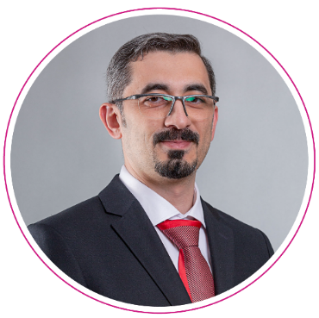
Academic Qualifications: Information Systems Engineering specializing in Software Engineering, Syrian Virtual University Diploma in Computer Engineering, Damascus University Intermediate Institute for Computer Engineering Certified ScrumMaster (CSM) ITIL® Foundation Certificate in IT Service Management ISO 20000 Participant MCSA Web Applications MS: Programming in HTML5, JavaScript, and CSS3 Angular: The Complete Guide to Angular by MaximillianSchwarzmuller Ionic: Build iOS, Android & Web Apps with Ionic and Angular by MaximilianSchwarzmuller | Educational Qualifications and Professional Certifications | Anas Nablusi SpecialistITIL
The internal and external portal for the Eastern Health Cluster. System for Resolving Violations of the Competition System for the General Authority for Competition Business Process Automation and Digital Transformation System for Internal Services, Ministry of Economy and Planning (70 human resources services and department and agency services) Unified Reports and Dashboard PlatformMEP 360- Ministry of Economy and Planning (budget dashboards, finance, contracts and procurement, project management, human resources) Achievements Certification System - Ministry of Economy and Planning, it was delivered and launched at the Ministry of Municipal, Rural Affairs, and Housing with an official letter addressed to the Ministry of Economy and Planning. Setting up the account for the Ministry of Economy and Planning inAzure CloudAndOffice 365And perform the integration (اتحادBetween theLocal Active DirectoryAndAzure Active Directory Publishing the Ministry of Economy and Planning's applications securely and implementing single sign-on and two-factor authentication relying on a service.Azure Application ProxyRemote work opportunities Development and technical support for the internal and external portals, development of the G20 website, development of the international partnerships system - Ministry of Economy and Planning Creating a development and testing environment inAzure CloudFor developers, Ministry of Economy and Planning | Professional Experience

Slide 51
Mansoura University Accounting 2013 Bachelor of Commerce | Educational Qualifications and Professional Certifications | Ramzy Ahmed IT Asset Inventory Specialist
إدارة المشاريع مالي SQL تحليلي ORACLE CLOUD INFRASTRUCTURE تحليل الأعمال تحليل البيانات إدارة البرامج PAAS Extension Problem Solving Excellent knowledge of the flow between SCM and financial. Strong Technical Aptitude: A deep understanding of Oracle Cloud Supply Chain Management (SCM) modules, such as inventory management, procurement, order management, and Product Hub. Skills in Analysis and Problem Solving: Understanding complex supply chain processes, identifying areas for improvement, and providing effective solutions. Strong problem-solving skills to address issues faced by clients and optimize supply chain workflows efficiently. Client-Focused Mindset: understanding client requirements, developing customized solutions, and delivering projects within scope and timeline. قابلية التكيف والتعلم المستمر: أن تكون متكيفًا ومنفتحًا لتعلم التقنيات الجديدة. مهارات إدارة المشاريع: بما في ذلك القدرة على التخطيط والتنظيم وتحديد أولويات المهام. القدرة على فهم تطبيقات أوراكل وحل المشكلات عند ظهورها في الإنتاج وتوثيق المشكلات في نظام إدارة المشكلات. | Skills
Accenture United Arab Emirates AUG 2021 – PresentPrincipal Consultant APPSPRO Saudi Arabia OCT 2017 - July 2021-كبير مستشارين Impact Saudi Arabia Jan 2017 - Sept 2017 Experienced Consultant JEHAN Recruitment Saudi Arabia Senior Accountant AUG 2015 - DEC 2016 Oracle SCM Cloud 2018 Presales Specialist. Oracle Cloud Support Specialist Assessment. Oracle SCM Cloud 2018 Sales Specialist. Oracle SCM Cloud 2018 Solution Engineer Specialist. | Professional experiences and achievements | Current Job Title: (Write the job title) Writing the current company name of the employee

Slide 52
Executive Summary
Scope of work for the project
Project Implementation Methodology
The project implementation schedule
Organizational Structure and Team
Project assumptions
About the Digital Future Company
Our clients
Our Projects
52

Slide 53
Project Assumptions - Introduction
During the first phase of the project, the work methodology and related outputs will be reviewed with the employer, and any amendments related to the project scope and outputs will be agreed upon.
The project will also include agreements on the stakeholders involved in the project and the criteria for communicating with them regarding the request for meetings, feedback, or their participation in workshops. Based on that, a detailed plan for implementing the project will be determined, specifying all outputs and milestones.Milestones) Meetings, reviews, etc.
The advisory team will. AndTechnicianReviewing the use of best practicesأفضل الممارساتThe proposed list of best practices will be agreed upon for use by the supervising authority/project owner during the execution of the project.
The working hours of the team on-site will be according to the labor law in force in the Kingdom, with attendance outside of working hours for urgent and emergency cases.
Knowledge transfer sessions and workshops are held at the authority's headquarters by the project team.

Slide 54
Project Assumptions – Client Commitments
The company wishes to participateEmployers on behalf of the clientCompletely in the project to achieve the desired goals quickly and in the preferred manner, which includes a number of commitments that the company must focus on to ensure the project proceeds quickly and with high efficiency:
Adhering to the set plans. One of the most significant risks facing the project is the failure of participating entities to adhere to the set plans. Therefore, it is important to adhere to the plans to ensure the project's success and implement the roadmap on schedule.
Providing clear requirements, to avoid any misunderstandings or any problems that may arise during project implementation, we request that demands and needs be submitted in writing and clearly, according to the project management methodology related to the process of managing the project scope.
Obtaining information and communication methods, whenever work requires communication with the concerned departments, it is necessary for the officials to do so.ClientEffective contribution to facilitate the communication process with these departments, in addition to facilitating access to available information sources.
Review the outputs according to the agreement that will be determined between the parties in the first phase of the project, with a focus on specifying clear and explicit notes regarding any necessary changes (if any) to the outputs.
The speed of approving the final outputs and the speed of approving the financial invoices related to the company's rights upon completing the outputs according to the deliverables and payments schedule that will be approved for the project.

Slide 55
Project Assumptions – Company Obligations
The company wishes to clearly and explicitly define its commitments to ensure the project is completed with the required quality.
The company is committed to providing our best experts and specialists to carry out work tasks, ensure quality, and successfully complete the project, achieving the desired general and detailed objectives.
The company is committed to fulfilling all the requirements specified in the terms and specifications booklet related to this technical proposal.
The company considers that customer needs are the priority in the partnership relationship with the client and that the client's success is the actual success of the company. We will strive to provide all available resources to implement the project with high quality and complete success.
The company is committed to using the best global practices in its consultancy work.TechnologyTo ensure maximum benefit from the in-depth expertise in the required business fields for its consulting and technical projects.
The company is committed to complying with all governmental guidelines and directives related to the nature of its consultancy and technology project operations with governmental sector clients in the Kingdom of Saudi Arabia.

Slide 56
Executive Summary
Project scope
Project Implementation Methodology
Project Implementation Schedule
Organizational Structure and Team
Project Assumptions
About Digital Future Company
Our clients
Our Projects
56

Slide 57
ShAl-Mustaqbal, a leading company classified in digital transformation, provides integrated solutions for information systems, resource management, business automation, artificial intelligence systems, and cybersecurity. It also designs and operates data centers, and offers technical consulting and information governance.
To be the distinguished and strategic partners for entities and organizations in enhancing digital technical work.

Slide 58




Our vision
Maintaining a leading position in the digital market in everything we do by offering the latest integrated solutions and expanding the scope of our offerings and services in the market.
Our message
We aspire to achieve sustainability and support our clients in continually competing in the business market through our technological services, and providing integrated digital solutions in business fields.
Work Charter
We bear the responsibility of transforming the business system for the better and achieving the aspirations and goals of our customers.

Slide 59





Social responsibility
Capable of shouldering the responsibility of business systems for entities and companies, and the responsibility of individuals by developing and training national cadres with global expertise.
Professionalism
We have an outstanding creative team capable of providing high-level digital technical services.
Commitment
We are committed to achieving integration over time with the quality of performance and enhancing the value of the work in accordance with the client's cost.
Trustworthiness
We process and organize data and information with complete confidentiality.

Slide 60


Our Services
Strategy, Planning, and Performance Measurement
Corporate Governance
Administrative Structuring and Organization
Business and Technology Solutions
Management and technical consulting
Digital solutions
Support services
Artificial Intelligence and the Internet of Things
Educational and training services
Educational Technology

Slide 61
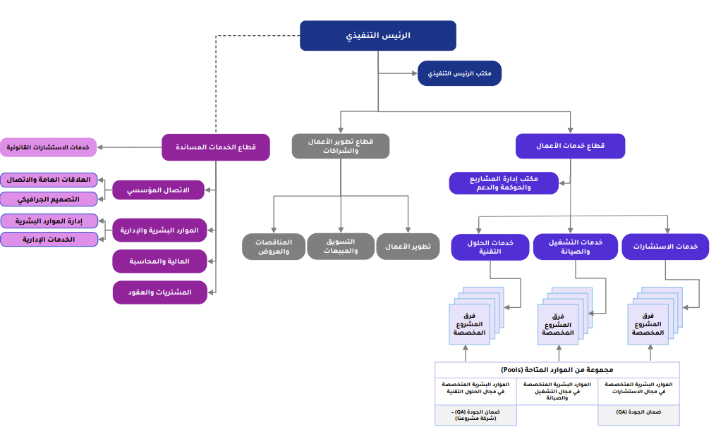
Company Organizational Structure

Slide 62
Executive Summary
Scope of Work
Project Implementation Methodology
Project implementation schedule
Organizational Structure and Team
Project assumptions
About the Digital Future Company
Our customers
Our projects
62

Slide 63


































We had the honor of working with several entities in both the private and public sectors.

Slide 64
Executive Summary
Scope of Work of the Project
Project Implementation Methodology
Project implementation timeline
Organizational Structure and Team
Project assumptions
About Digital Future Company
Our clients
Our projects
64

Slide 65
Selected Projects for the Digital Future*
The second phase of the digital transformation project at the Ministry of Industry
Operation and maintenance of the spatial portal and spatial dashboards and indicators.
Providing consultancy services and support for digital capabilities management
Data preparation, design, structuring, and governance.
Comprehensive Application for the Technology Project Management Office
Geospatial solutions programs
Development of the internal and external portal for the Eastern Health Cluster.
Technology governance, structuring, and implementing the technology strategy for the Ministry of Interior.
Providing consulting services and providing technical support services.
Provision of consultancy services for the development of the Water Regulator's business.
Providing consultancy services and technical support to develop a unified vision for the Ministry of Environment, Water, and Agriculture.
Developing criteria for incorporating promising and leading national companies.
Development of services for procedures at the Ministry of Interior's Agency for Military Affairs, Phase One
Development of electronic services for project management and providing technical and strategic support for the ministry.
Project details in the attachments

Slide 66


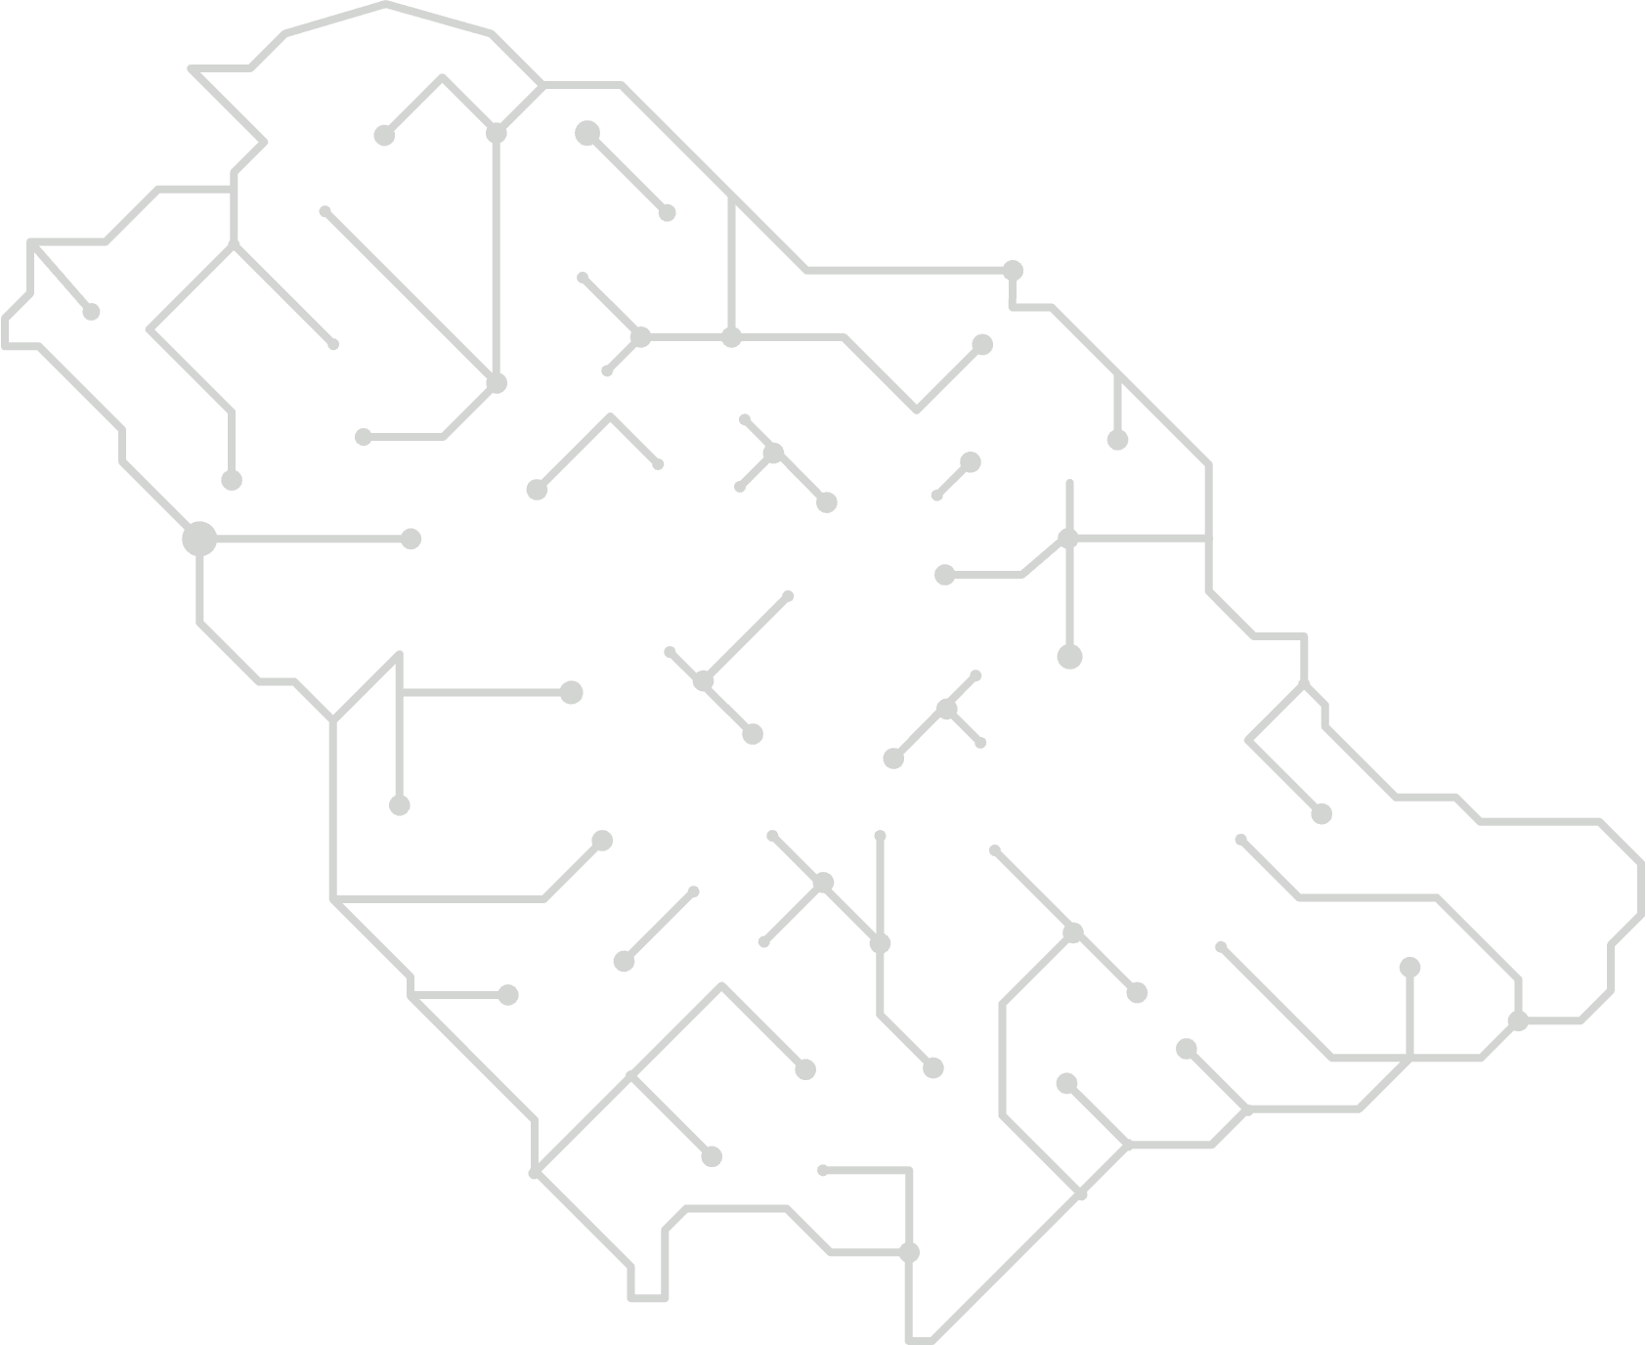
A sample of some projects we had the honor to execute.
15 months
(05/2023 - 08/2024)
Project duration
NameThe project
Development of the internal and external portal for the Eastern Health Cluster.
Project Overview
The Eastern Health Cluster seeks digital transformation and keeping pace with rapid changes in electronic government services in line with Saudi Arabia's Vision 2030. This will be implemented through the design and development of the internal portal for cluster staff and the external portal directed at the general public including reviewers, visitors, and others.
Sure, please provide the text you want translated.
Outputs
Scope of Execution
Implementation and preparation of the application management systemDevOps
Application Development Policies and ProceduresSDLC
Gate environments preparation (development, testing, production environment)
Launch of the internal and external portal
Periodic reports on operation and technical support activities
Lessons learned report and project delivery completion.
Delivery of all approved project documents
Delivery of the source code after the completion of development work.
The document of the approved work methodology for the project and its approval.Sure, please provide the Arabic text you would like to be translated.
The approved detailed plan for the project and the approval of the project team.
Project charter including the work plan
Report on Project Kick-off Meeting
Business Requirements Document
Architectural documents and system designSolution architecture, HLD, DLLD
Design of the internal and external gate
Current Status Document for Applications Management and Digital Health

Slide 67

A sample of some projects we were honored to implement
12 months
(0Five/2023 - 0Four/2024)
Project duration
Project Name
Geospatial Solutions Program Project
Project Overview
Supply licenses and maintenance for the solutions programGeospatialSure! Please provide the text you need translated.
Scope of Execution
Outputs
ArcGIS Enterprise Fريق العمل Standard
ArcGIS Enterprise Standard استحقاق
ArcGIS Developer Enterprise
ArcGIS Image Analyst
ArcGIS Desktop متقدم
ArcGIS Desktop Standard
ArcGIS Spatial Analyst
ArcGIS Enterprise متقدم

Slide 68

A sample of some projects that we had the honor of executing.
DurationThe project
Project name
The comprehensive application for the technology project management office.
Project Overview
The scope of the project involves providing consultancy services for the establishment and operation of both the Technology Project Management Office and the Enterprise Architecture Office inTechnology Affairs At the Ministry of Interior.
Scope of execution
Outputs
Support and operation of the Enterprise Architecture Office
Training and knowledge transfer.
Supporting and Operating the Project Management Office
Developing the methodology and processes of the Project Management OfficeProject Management Office
Development and Support of the Enterprise Architecture OfficeEnterprise Architecture Office
Design, installation, development, and testing of the project management system.

Slide 69
A sample of some projects we had the honor to execute.
Project duration
18Month
(02/2023 -09/2024)
Project name
Data preparation, design, structuring, and governance.
Project Overview
The scope of the project involves providing consultancy services for preparing, designing, structuring, and governing the target data architecture to enable the digital transformation roadmap.
Outputs
Scope of Implementation
Evaluation Phase Report.
Determination of interim reports
Infrastructure Phase Report
Target Architecture Phase Report
Digital Transformation Roadmap Phase Report
Operation phase
Enterprise Architecture Package - 5 Users

Slide 70

A sample of some projects we were honored to execute.
Project duration
Project Name
Providing consultancy services and support for digital enablement management.
Project Overview
The scope of work includes establishing and developing the digital enablement management in the Saline Water Conversion Corporation.
Outputs
Scope of Execution
Preparing the Job Description Document for Digital Enablement Management
Preparation of a document on the distribution of roles and responsibilities among organizational units
Preparing a Document for Measuring the Quality of Digital Services
Preparing a document for a plan to enhance interactive relationships with stakeholders
Preparing a Training Needs Analysis Document for Digital Enablement Management
Preparing the training plan document for the development of the employees of the Digital Enablement Administration in digital transformation
Preparing a leadership development plan document for digital enablers management.
Preparation of the Current and Future Status Document
Preparing a digital transformation strategy document for managing digital enablers
Preparation of a Digital Assets Management Roadmap Document
Preparation of the Digital Asset Management Implementation Plan Document
Preparing the operational framework document for digital asset management
Preparation of a Governance Document for Digital Asset Management
Preparation of the Institutional Change Management Support Document

Slide 71
A sample of some projects we had the honor of executing
24 months
(06/202507/2023)
Project duration
Project name
Operation and maintenance of the spatial portal, dashboards, and spatial indicators.
Project Overview
The Nuclear and Radiological Regulatory Authority desires technical and advisory support, operation, and maintenance for all components of information systems.
Geography, in addition to spatial data and information panels and indicators, in order to achieve objectives and ensure the continuity of the system's operation with all its components without obstacles or issues that may hinder daily operations. This is achieved by providing appropriate technical and advisory support, improvements, and modifications to the current system to meet the objectives and aspirations of the organization and comply with its new requirements. It also involves assisting in implementing upgrades on the operational components of the systems to enhance performance and reliability.
Scope of Implementation
Outputs
Geographic Information System Server Software Licenses.
License for a spatial statistical analysis tool for desktop GIS software.
A tool license for spatial analysis for desktop geographic information systems software.
Geospatial Database Administrator
Geographic Information Systems Analyst
Geographic Information Systems Application Developer
Geographic Information Systems Application Developer
Office licenses for geographic information systems softwareArcGIS سطح المكتب متقدم ترخيص ArcGIS Pro

Slide 72


A sample of some projects we had the honor to execute.
Project Duration
Project Name
Phase Two of the Digital Transformation Project
Project Overview
The scope of the project involves building a digital infrastructure to enhance and achieve the goals of Vision 2030 by seizing the opportunities available in the digital age, achieving economic sustainability, attaining global leadership, and improving quality of life.
Outputs
Scope of Implementation
Identifying the digital gap.
Defining the digital transformation plan.
Identify and monitor the key success factors for digital transformation.
Identifying and monitoring the critical success factors for digital transformation.
Defining and monitoring digital performance indicators.
Periodic monitoring of the digital transformation plan.
Analysis of the current situation.
Identifying needs.
Feasibility study of digital platform applications and analysis of the latest modern technologies.
Updating and developing the digital transformation strategy.
Defining digital governance.
Establish and define the operational plan for the Digital Transformation Office.

Slide 73

A sample of some projects we were honored to execute.
12 months
10/2020 – 10/2021
Project duration
Project name
Development of electronic services for project management and providing technical and strategic support to the ministry
Project Overview
The Digital Future Company contributed to the implementation of a project providing consultancy services to develop a unified vision for the Ministry of Environment, Water and Agriculture in line with Saudi Arabia's Vision 2030, aimed at improving performance and enhancing capabilities and project management. This includes strengthening the project management team to enable the administration to achieve its goals within the framework of the Ministry's plan, which involves adopting and applying the best global practices (methodologies, project management systems, and techniques).
Outputs
Scope of Implementation
Program and Project Portfolio Management
Office model, organizational structure, and governance framework
Policies and Procedures Manual
Project Management System
Organizational Structure, Policies, and Procedures
Development of electronic services
Current Situation Assessment Report
Technical tool analysis
Design and development of the operational model for technical programs.
The study of the enhancement program is submitted to the strategic committee.
National Agriculture Strategy Report and Executive Summary
Comprehensive Development Plan
The operational model for the project office.

Slide 74
A sample of some projects we were honored to execute.
DurationThe project
Project Name
Development of Services for Work Procedures at the Ministry of Interior's Agency for Military Affairs, Phase One
Project Overview
The Ministry of Interior's Agency for Military Affairs wishes to implement the first phase of the project to develop work procedures services at the Ministry of Interior's Agency for Military Affairs, to employ and use it in the Ministry of Interior's Agency for Military Affairs, and to assist decision-makers inThe Ministry of Interior's Military Affairs Agency aims to provide the best services, increase productivity at the lowest costs, and review the status of the institution's projects.And follow-up
Scope of Implementation
Outputs
Development Works Development Solutions Works ImprovementWork procedures
Development Works DevelopmentWeb services and their integration with the business platform.Digital Good news Interior

Slide 75
A sample of some projects we had the honor to execute
6 months
(02/2023 - 08/2023)
Project duration
Project name
Project for Developing Standards for the Inclusion of Promising and Leading National Companies
Project Overview
Develop a list of 800 or more "leading" and "promising" Saudi companies (including details on each specified criterion), which could be considered in the future for receiving government support, as this support is likely to lead to growth and international expansion including outward direct investment (ODI). This involves refining and improving the current criteria used to classify national companies as "leading" and "promising" in terms of future expansion and international growth. Apply the criteria to existing Saudi companies to identify 700 "leading" national companies and 100 "promising" ones.
Scope of implementation
Outputs
Current Situation Analysis Document
Operating Model Document
A final list of 800 national companies (700 leading and 100 promising).

Slide 76
A sample of some projects we had the honor to execute.
Project duration
Project Name
Providing consultancy services and technical support to develop a unified vision for the Ministry of Environment, Water and Agriculture.
Project Overview
The project is based on providing advisory and technical support to the ministry to achieve its objectives and to implement the outcomes of the project offering consulting services and technical support to develop a unified vision for the Ministry of Environment, Water and Agriculture, by carrying out the following specified tasks and services for the Ministry of Environment, Water and Agriculture. The scope of the project consists of the following axes:
Axis One: Consultancy services for studying, researching, and investigating data on agricultural lands in the Al-Jawf region.
Axis Two: Study the current state of vegetation cover in the Kingdom of Saudi Arabia and provide solutions to preserve and develop it.
Axis Three: Strategic support for the studies required by the ministry, during the project period.
Scope of Implementation
Outputs
Study to Assess Quantities of Agricultural Waste
Executive Regulations for the Environment Sector
Risk Management Plan
Consulting Services
Study of the Current Status of Vegetation Cover in the Kingdom of Saudi Arabia
Strategy for Allocating Existing Desalinated Seawater Production Assets

Slide 77

A sample of some projects we had the honor to implement.
Project duration
Project Name
Providing consultancy services for developmentWorksWater regulator
Project Overview
The scope of the project involves implementing a project to provide consultancy services for the development of the water regulator's operations, through offering advisory and technical support to the water regulator to achieve its objectives.
Dashboard and performance monitoring reports design
Organizational development for the water services provider:
Service Performance Level Document
Operations and Procedures Manual
Job Descriptions Guide
Risk Management Plan
Identifying the needs and requirements necessary for developing the Water Regulator's operations.
Outputs
Scope of execution
Executive planning and performance measurement for the organizer's tasks:
Current Situation Diagnosis and Benchmarking Document
Operating Model Document
Guide to Initiatives and Projects
Roadmap Document
Operational Plan Document
Guide to Workplace Development Standards
Definition and establishment of performance indicators for the departments of the organization.
Nomination of a number of technical solutions with a comparison between them along with recommendations.

Slide 78
A sample of some projects we were honored to implement
Project duration
Project Name
Providing consultancy services and providing technical support services
Project Overview
The project's scope of work involves providing consultancy services and technical support services for the project "Operation and Application of Urban Development and Enhancing Cooperation with Related Agencies (Phase Two)."
Outputs
Scope of Implementation
Providing project management services throughout the project duration.
Providing various specialized operational consulting services throughout the project duration.
Design and develop project reports so that standardized and approved templates are established.
Design and printing of the outputs of the project for implementing urban development and enhancing cooperation with relevant agencies (Phase Two).
Printing the urban development priorities atlases and the execution tables for each city, and preparing the necessary outputs for presentation to the regional councils (Task Two).

Slide 79


A sample of some projects we had the honor to execute.
Project duration
Project Name
Technology Governance and Structuring Project and Implementation of the Technology Strategy for the Ministry of Interior
Project Overview
The scope of the project's work involves providing consulting services for technology governance and structuring, as well as implementing the technology strategy for the Ministry of Interior.There is no text provided to translate.
Outputs
Scope of Implementation
Preparing a Plan for Identifying Training Needs
Preparing a document on the top 10 technical challenges
Defining information technology rules and regulations to simplify technology governance
Preparing the Technical Structure Document for Technical Alignment
Development of a technology strategy management system and performance indicators measurement
Development of the administrative business system
Analysis and study of technical projects and initiatives (project funding sources)
Definition of information security standards for mobile phone communications
Definition of Information Security Standards for Vehicles
Preparation of electronic training course documentation in the field of management and human resources
Preparation of the electronic training courses document in the field of technology
Technology Strategy Preparation
Preparing the Technology Policy Document
Preparing a digital transformation plan
Preparing the Strategic Map for the General Administration of Information Technology
Developing a Digital Transformation Roadmap for IT Management

Slide 80
Thank you.

